Slide 1
Enhanced Learning with Music Therapy
CSE 5369/6369 Human Computer Interaction
1st Project Presentation
Spring 2016
DANYAL OZAIR
MUDASSIR AHMED MOHAMMED
TASNIM MAKADA

Slide 2
AGENDA
Brain waves
Why Alpha State?
Music
Binaural Music
Goals
Related Work
Pointers from Related Work
Approach
Use Cases
Team members’ work
Timeline
Performance
Pilot Study
Current Progress and Issue Faced

Slide 3
BRAIN WAVES
In 1924, a German physiologist and psychiatrist named Hans Berger recorded the first human EEG.
Brain waves are divided into five different bandwidths that are believed to create a spectrum of human consciousness.
Delta waves (.5 to 3 Hz) occur primarily during our deepest state of dreamless sleep.
Theta waves (3 to 8 Hz) occur during sleep but have also been observed in the deepest states of Zen meditation.
Alpha waves (8 to 12 Hz) are present when consciously practicing mindfulness or meditation.
Beta waves (12-30 Hz) is a ‘fast’ wave that is present when we are alert, attentive, focused, and engaged in problem solving.
Gamma waves (25 to 100 Hz) fastest of the brain wave. Gamma waves relate to simultaneous processing of information from different brain areas and have been associated with higher states of conscious perception.
Notes:
We started with research on brain waves…in 1924… our brain is releasing brain waves all the time. Raw EEG signal are difficult to understand, but with today’s technology we can filter the signal and make sense out of it. We are using a device Muse for our experiment.
Brain waves categories explained.

Slide 4
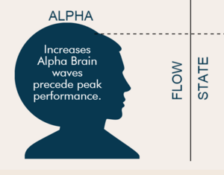
Why Alpha State?
It is the athlete's peak performance state and the inventor's creativity.
Creative works like General Theory of Relativity, Archimedes principle.
Mind is clear, receptive to information, and rapidly makes 'connections', realizations and joins up thoughts.
Produced before and after sleep.
Relaxation Response.
Notes:
Have y’all ever felt of perfect concentration and focus when you’re working or studying. Time is not distraction or not hungry. The mind is in flow state.
It’s the athlete’s peak performance.

Slide 5
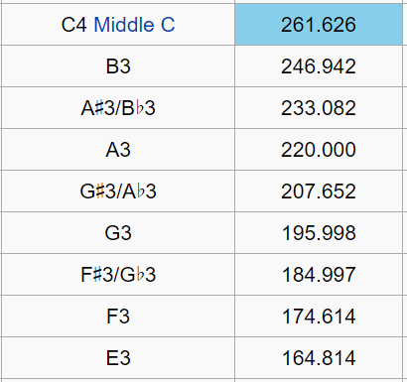
Music
Do you know how there are certain songs that when you hear them you feel good.
Do you know there are some songs in foreign languages that we don’t understand but we still love them.
How are some songs are a hits and others are not?
For Ex: Do a deer, a female deer – Sound of Music
E3 – F3: 174.6 - 164.8 = 9.8 Hz (Alpha Frequency: 8-12 Hz)
Binaural Music

Slide 6
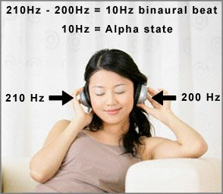

Binaural Music
When signals of two different frequencies are presented separately, one to each ear, your brain detects the difference between the frequencies and tries to resonate with that difference.
Alpha Binaural Waves frequency between 8Hz -12Hz.

Slide 7
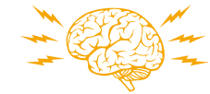
GOALS
Optimizing Human Performance.
Doing a Research on Alpha State of mind.
Doing a research on the relationship between Music and Alpha State of mind.
Analyzing subjects performance before and after music therapy/relaxation and, monitoring through brain waves.

Slide 8
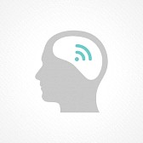
RELATED WORK
Special Education: Music Therapy Research and Evidence-Based Practice Support
A Preliminary Study on the Effects of Music on Human Brainwaves - Hasminda Hassan , Zunairah Haji Murat, Valerie Ross and Norlida Buniyamin
Still-Breathing
Notes:
Work

Slide 9
POINTERS FROM RELATED WORK
Investigation indicate that while listening to a live performance of violin music, the subject's brain induced brainwaves.
The study points to a possible relationship between frequency and power emitted by music in affecting human brainwaves, suggesting further research in this domain.
Outcomes on Subject:
Decreased agitation
Relaxed
Focused
Increased feelings of pleasure
Notes:
Work

Slide 10
APPROACH
Step 1: Study brain waves
Step 2: Understand and Interpret Brain Waves
Step 3: Testing on different subjects to know whether music enhances learning
Step 4: Data gathering through MUSE
Step 5: Analyze results using Statistical model
Notes:
Add sub descriptions

Slide 11
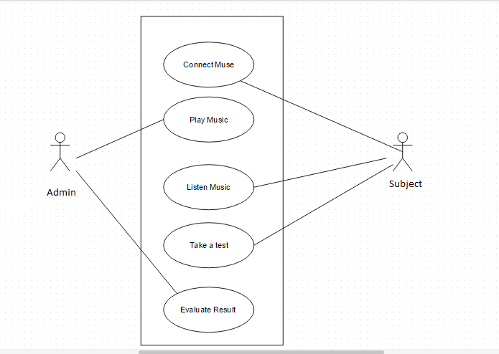
Use-case Diagram

Slide 12
TASKS
Team member | Task
Danyal Ozair | Domain Research, Research on affects of Music on alpha, creating tests for experiment
Mudassir Mohammed | Domain Research, Information Gathering, Result Analysis
Tasnim Makada | Domain Research, Data filtering, Data Processing Tool: MATLAB
Notes:
Design an app which alerts using visual, audio and sensory stimulation
Researching and analysing brain waves, field work, domain research, data filtering

Slide 13
TIMELINE
Week 1: Research on Muse and Brain waves for lie detection
Week 2: Research on brain waves for drowsy driving
Week 3: Data collection with Muse using Driving Simulator
Week 4: Analysis and interpretation of data
Week 5: Research on brain waves for analysing learning patterns with/without music.
Week 6,7,8: Work on streamlining the data
Week 9: Integration of data analysis with UI and testing
Week 10: Use it for real life participants to evaluate and corroborate findings.
Notes:
Week 1: We researched about how to use Muse and brain waves for lie detection
Week 2: We found that Muse is not appropriate for lie detection and hence changed our focus to getting data for attention. Researched in-depth about brain waves and Muse
Week 3: Data collection using driving simulator
Week 4: Work on analysing data collected
Week 5: Interpreting data and working on getting data usable for android app
Week 6: Same
Week 7: Same plus android app
Week 8: Same plus android app
Week 9: Collaborate app with muse working well
Week 10: Testing
Week 11: Updates as required

Slide 14
PERFORMANCE REQUIREMENTS
Muse and sensor connectivity verification
Data validation
Remove noise from brain wave data and extracting the alpha wave from data
Mental Stability of a Person undergoing experiment

Slide 15
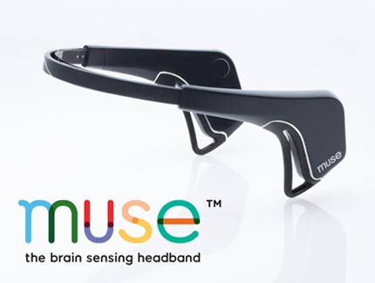
PILOT STUDIES
Low Fidelity Prototype
We tested with Muse on 4 participants
Consistently, Music increased Alpha waves
100% success rate
High Fidelity Prototype
We sent out a survey to a number of students
The results are in the following slides
15
Notes:
New results with driving simulator
http://framesynthesis.com/drivingsimulator/2d/

Slide 16
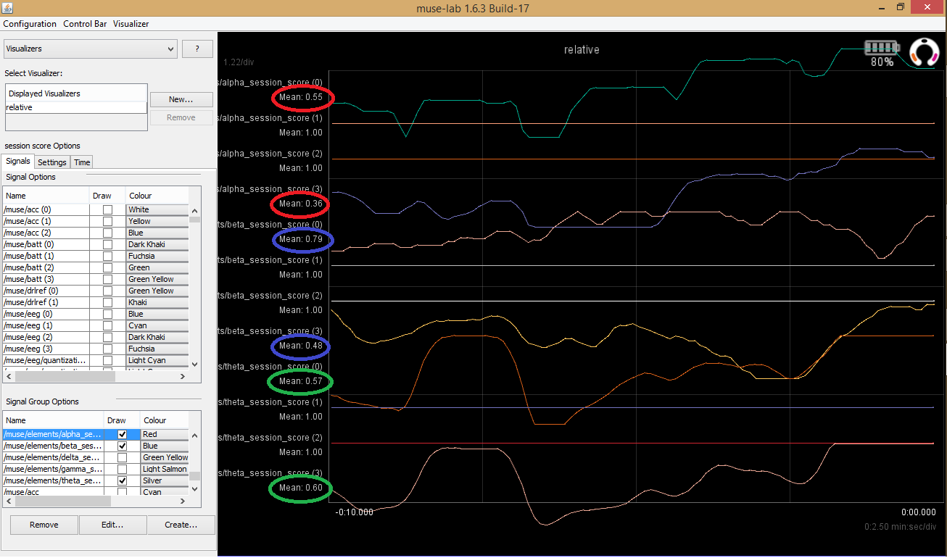
Active thinking
Notes:
drowsiness

Slide 17
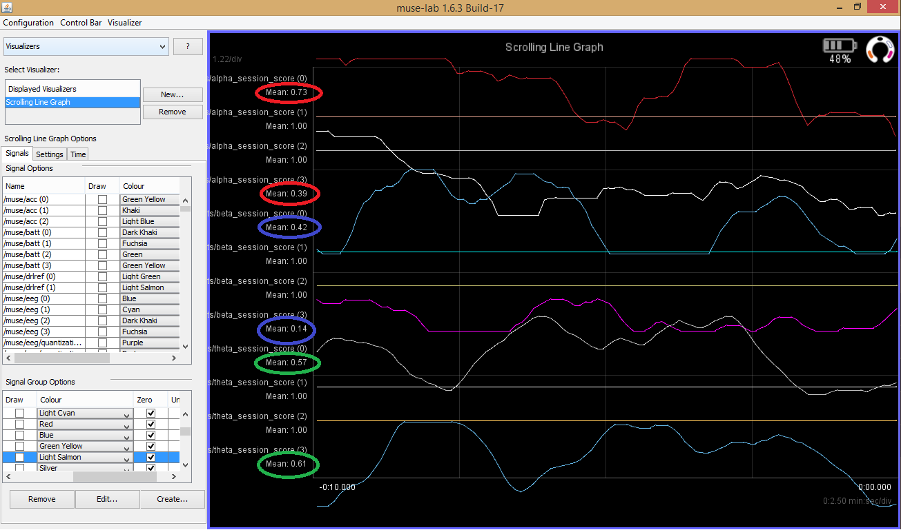
Relaxed
CSE 5369/6369 Human Computer Interaction
17
Notes:
active

Slide 18
Findings
Notes:
Add pictures and videos
https://www.youtube.com/watch?v=tjBPzPAEvMM

Slide 19
Survey Approach
Beta waves are high during critical thinking, solve problems to increase it
Solve memory questions
Alpha waves are heightened by listening to music
Solve similar questions again
Analyze results
Notes:
The unit of the brainwaves is Power Spectral Density (PSD) is a measure of power. So it basically indicates how much power is contained in certain frequencies.
We will mainly collect data from Fp1 and Fp2 spots on the our forehead. (image)
Theta wave is showing unexpected values. It should be high when the subject is sleepy and low in normal state, which is not the case according to our experiment.
Theta value is ranging from maximum to minimum. Apparently, it reaches maximum even when a person is in active state.
As of now not much can be inferred from the data except Alpha brainwave.
The muse should be properly connected to head so that all four sensors are giving the correct value, this should be considered when the person is actually driving the car.
Here are the some of the positive developments from our experiment:
The relative values of alpha and beta are actually making sense.
Relative theta values goes high during drowsy state sometimes.
Alpha values is higher when you close your eyes, yawn or feeling sleepy.

Slide 20
SURVEY ANALYSIS

Slide 21
SURVEY ANALYSIS
Notes:
Beta Test Alpha Test Image Verification Accuracy 29.93 34.7

Slide 22
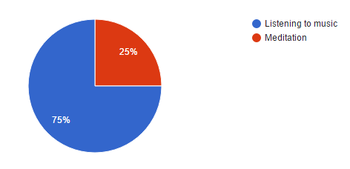
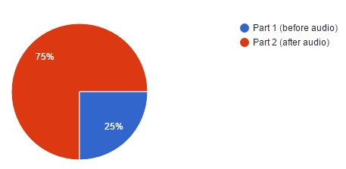
Participant Preferences
Which do the participants prefer
Which section was easier

Slide 23
Current Progress and Issues
Using Muse for taking readings while performing learning tasks.
Analyze and manipulate data to extract only relevant information
Work on UI approach
Work on data processing using MATLAB
ISSUES
Research included working on 2 project ideas before adopting the current idea
Consistent data is not obtained since tiny movements affect readings

Slide 24
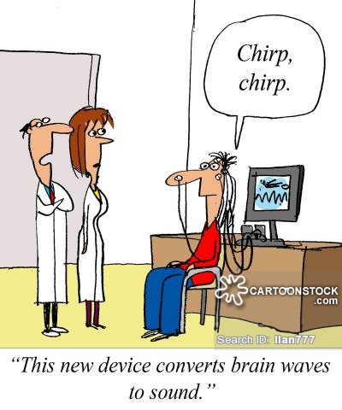
SHORT DEMO

Slide 25
THANK YOU

